Slide 1
So You have ev buses on the way;
what should be done next
2023 CASTO School Transportation Business Management Forum
Jim Burleson
Execuitive Director of Transportation
October 12, 2023

Slide 2
Agenda
1.
2.
3.
4.
5.
MVUSD TRANSPORTATION DEPARTMENT BREAKDOWN
Preparing for Ev bus arrival
charging basics
complications & challenges
range & mileage
6.
7.
8.
9.
10.
Operating costs
Fuel cost comparisons
Looking back
questions
Closing remarks

Slide 3
MVUSD Leadership Transportation Team
Jim Burleson Executive Director of Transportation
James Sanford Transportation Manager
Tammy Fawcett Transportation Supervisor
Israel Amezcua Lead Mechanic
#MVUSDGoBeyond

Slide 4
Our 161 Transportation Team member Breakdown
SECRETARY& ACCOUNT CLERK
2
DISPATCHERS 5
SCHOOL BUS DRIVERS 117 ( 9 VACANCIES )
SCHOOL BUS DRIVER TRAINEES 22
VAN DRIVERS 3
SCHOOL BUS MONITORS 22 ( 1 VACANCY )
SCHOOL BUS DRIVER TRAINERS
2 BEHIND THE WHEEL TRAINERS 3
MECHANICS 7
POSITION CONTROL RATIOS
SCHOOL BUSES PER MECHANIC
30
TEAM MEMBERS PER MANAGER
54

Slide 5
Mvusd school bus fleet: 117 School buses / by fuel type
42 (46) – Electric Powered School Buses
28 (40) - Renewable CNG Powered School Buses
13 – Gasoline Powered School Buses
30 – Propane Powered School Buses

Slide 6
Our partners

Slide 7
Grant support from
Notes:
https://www.youtube.com/watch?v=ORWMTiiJTpY

Slide 8
Grant funding & project cost
For 42 electric buses and infrastructure
Total bus and infrastructure cost $16M
Total grants and considerations $10.5m
District funding $5.5m
#MVUSDGoBeyond

Slide 9
PREPARING FOR YOUR ELECTRIC SCHOOL BUSES
SHORT AND LONG TERM PLANNING
YOUR TEAM
YOUR PARTNERS
OUTSIDE BUSINESS SERVICES DEPARTMENTS
TRANSPORTATION YARD
STUDENTS AND COMMUNITY
NEW BUSES AND DRIVERS READY TO TRANSPORT STUDENTS
PATIENCE, COMMUNICATION, COLLABORATION, PATIENCE
#MVUSDGoBeyond

Slide 10
CHARGING BASICS
LEARN, ORGANIZE, THEN EXECUTE WITH CONFIDENCE
KNOW YOUR INDIVIDUAL ROUTE MILEAGES, TIMES, RIDERSHIP, TERRAIN, DRIVERS
KNOW YOUR EV BUS BATTERY CAPACITY, RANGE, STUDENT CAPACITY, CHARGING PORT LOCATIONS, ESTIMATED kW’s PER MILE, LOCAL WEATHER CONDITIONS
FAMILIARIZE YOURSELF WITH YOUR CHARGING SOFTWARE PRIOR TO BUSES ARRIVING, DON’T BE AFRAID TO MAKE SPECIAL REQUESTS TO FIT YOUR DEPARTMENTS NEEDS, COMPLETE DATA ENTRY
COLLABORATE WITH YOUR LOCAL UTILITY, TALK FREQUENTLY, BUILD EXCITEMNET AROUND YOUR PROJECT, KNOW UTILITY TIERS, RATE STRUCTURES BY TIME OF DAY, KNOW YOUR LOAD LIMIT, MAKE SURE YOUR CHARGING INFRASTRUCTURE IS DESIGNED TO MEET ALL OF YOUR UTILITY NEEDS.
BUILD AN EFFICIENT AND COST EFFECTIVE CHARGING SCHEDULE
FIT SCHEDULED CHARGING IN YOUR OFF-PEAK HOURS
LOOK TO MAXIMIZE SUPER OFF-PEAK HOURS IN THE FALL AND WINTER
BE PREPARED TO MONITOR YOUR FIRST FEW MONTHS CLOSELY TO ENSURE BUSES ARE READY TO GO EACH MORNING! THIS IS CRUCIAL FOR THE SUCCESS OF YOUR PROJECT, BE ENGAGED.
Notes:
https://www.youtube.com/watch?v=ORWMTiiJTpY

Slide 11
COMPLICATIONS & CHALLENGES
LESS THAN EXCITED…. THERE WILL BE THOSE RELUCTANT TO EMBRACE NEW TECHNOLOGY, POLITICAL VIEWS, YARD TALK
ADDITIONAL TRAINING HOURS PROFICIENCIES, PRE-TRIPS, DRIVER COMFORT
NEW TECHNOLGY SOFTWARE LEARNING CURVES, MECHANICAL FALIURES, CHARGING STATION WOES, INCREASED REPAIR TIMELINES, LENGTHY EQUIPMENT DIAGNOSTICS, UNEXPCTED COSTS
BUS MECHANICAL CHALLENGES LOOSE HARDWARE (CHASSIS BOLTS), RUBBING HOSES, ROOF LEAKS, EMERGENCY HATCH LEAKS, POWER STERING HOSE LEAKS, AIR CONDITIONER ISSUES, DOOR SWITCH & CHILD CHECK, DVOM MODULES DUE TO CHARGING HANDLES, TIRES.
CHARGER COMPLICATIONS
CONNECTIVITY, COMMUNICATION, BUS COMPATIBILITY, WEATHER RESISTANCE, SOFTWARE UPDATES, CABLE MANAGEMENT,

Slide 12
OPERATING COSTS (fuel only)
AFTER 327,517 ELECTRIC SCHOOL BUS MILES COMPLETED
AVERAGE kilowatt per mile 1.8
@ $.30 kilowatt
Per mile fuel cost
$0.54
Electric cost per mile $.54
@1.8 kw per mile
Cng cost per mile $0.68
@ 4.18 MPG
Propane cost per mile $0.90
@ 3.58 mpg
*no lcfs credits calculated
Other factors to consider for actual fuel cost per mile
lcfs credits
annual software costs
Equipment Extended warranty
Possible battery replacement
Early Tire replacement costs
Notes:
Presentation on the importance of attendance: https://doe.sd.gov/title/documents/AttendanceMatters.pdf
10 Facts about school attendance: https://www.attendanceworks.org/chronic-absence/the-problem/10-facts-about-school-attendance/

Slide 13
OPERATING COSTS (fuel & Maintenance)
AFTER 327,517 ELECTRIC SCHOOL BUS MILES COMPLETED
AVERAGE kilowatt per mile 1.8
@ $.30 kilowatt
Per mile fuel cost
$0.54
Electric cost per mile $.85
Cng cost per mile $1.29
Savings $144k Annual over CNG
Propane cost per mile $1.75
Savings $295k over propane
*no lcfs credits calculated
Other factors to consider for actual fuel cost per mile
lcfs credits
annual software costs
Equipment Extended warranty
Possible battery replacement
Early Tire replacement costs
Notes:
Presentation on the importance of attendance: https://doe.sd.gov/title/documents/AttendanceMatters.pdf
10 Facts about school attendance: https://www.attendanceworks.org/chronic-absence/the-problem/10-facts-about-school-attendance/

Slide 14
Looking Back What Would You Do Differently?
Initial plans would include a micro grid.
Select larger bus battery option battery
Installed one super charger
Started with SCE installing a larger transformer, 1500kva
Notes:
Presentation on the importance of attendance: https://doe.sd.gov/title/documents/AttendanceMatters.pdf
10 Facts about school attendance: https://www.attendanceworks.org/chronic-absence/the-problem/10-facts-about-school-attendance/

Slide 15
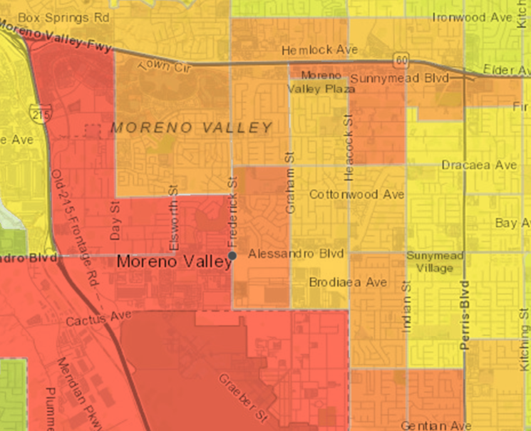
MORENO VALLEY AIR QUALITY
CAL ENVIROSCREEN IS A TOOL USED TO HELP IDENTIFY COMMUNITIES DISPROPORTIONATELY BURDENED BY MULTIPLE SOURCES OF POLLUTION.
THE MORENO VALLEY AREA IS IN THE 98th PERCENTILE OF THE ENVIROSCREEN. THE REPORT SHARES A HIGH PERCENTAGE OF ASTHMA, LOW BIRTH WEIGHT AND CARDIOVASCULAR DISEASE ALL A FACTOR OF THE DANGEROUS AIR QUALITY. IT IS CRITICAL THAT ADDRESS THE POOR AIR QUALITY OF OUR COMMUNITY
#MVUSDGoBeyond

Slide 16
ZERO EMISSIONS
DEPLOYING 42 ELECTRIC SCHOOL BUSES, WILL REDUCE CO2 EMISSIONS BY 549 METRIC TONS ANNUALLY. THAT IS THE EQUIVALENT TO REMOVING 260,863 PASSENGER CARS FROM THE STREETS OF MORENO VALLEY!
RENEWABLE ENERGY
SOLAR PANELS INSTALLED AT OUR PERRIS OPERATIONS CENTER PRODUCE NEARLY A MEGAWATT OF POWER.
OUR NEW CNG STATION FUELS 28 OF OUR SCHOOL BUSES WITH RENEWABLE CNG DERIVED FROM CAPTURED LANDFILL GASES. ENERGY REIMAGINED!
#MVUSDGoBeyond

Slide 17
Questions?
#MVUSDGoBeyond

Slide 18
Thank You and Let us
GO BEYOND!
. . . .
. . . .
. . . .
. . . .
. . . .

