Slide 1
Effective Recruitment Strategies
Melissa Chartrand & Zainab Nuhaily

Slide 2
Highlights
Company Branding
Compelling Job Postings
Diverse Marketing Strategy
Talent Search
Invest in Current Employees

Slide 3
Company Branding
Vision, Mission, and Values
Social Media
Employee Experience
Notes:
I am sure that you all have well established company brands
so we are going to quickly go through the company branding.
Investing in the company brand helps prospective applicants understand
what the company Vision Mission and Values. Company Logo and
Branding colors help build the identity.
Using Social Media exposes applicants to many different company
brands, marketing one different platforms help get visibility and stand
out in a crowd and gives the company a chance to take control over the perspective of the business.
Through company branding it helps customers build trust and loyalty.
Positive Employee feedback on your website can be an added value
All of these are important to prospective employees because helps
them to get a sense of company culture.
They want to know what they are getting into before the make the decision to make a commitment.

Slide 4
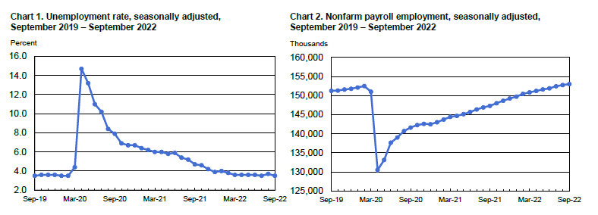
Company Branding
Notes:
It is currently an employee market.
According to the Bureau of Labor statics the unemployment rate in
September was down to 3.5% with more jobs being added in Hospitality, leisure and hospitality.
So what can you do to make your company stand out?
Why are employees going to work for you?

Slide 5
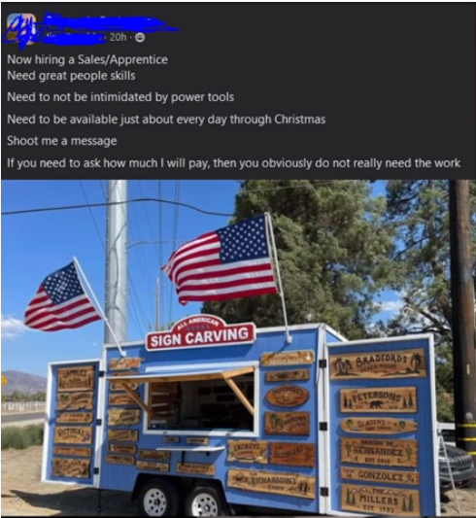
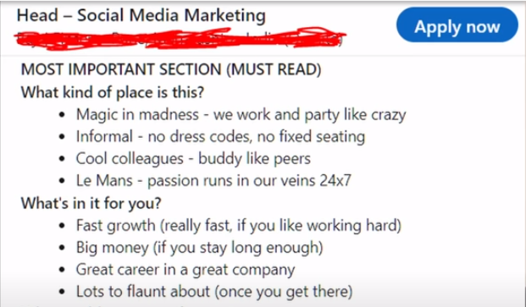
Job Posting
Notes:
When advertising for your positions make sure that you are clear in what you are looking for.
As you can see from the posting that woud

Slide 6
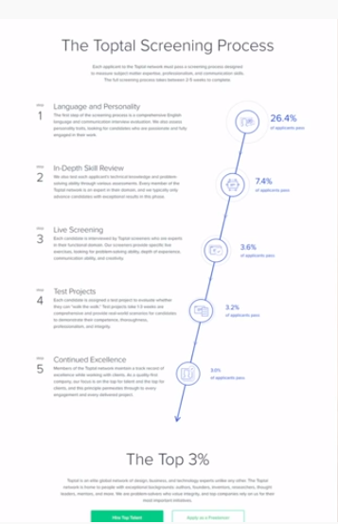
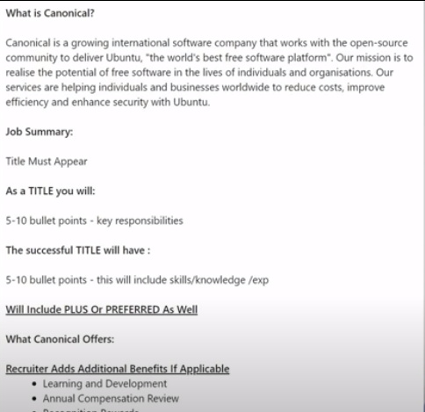
Job Posting
Notes:
When advertising for your positions make sure
that you are clear in what you are looking for.
You want to sell your company
Look into what is being said about you company.
Companies like Glassdoor allows employees and
former employees to give a "yelp" review on the company.

Slide 7
Job Posting
Notes:
When advertising for your positions make sure that you are clear in what you are looking for.
This Must Haves are listed on the Job posting for
Lululemon Manager for people & culture business partner.

Slide 8
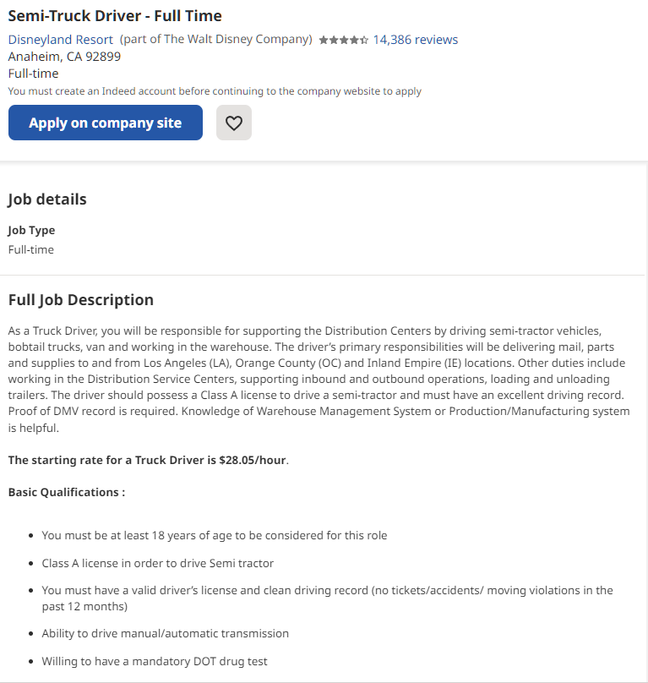
Creating the Job Posting
Describe the Position
Summarize the Role
List the Responsibilities
Easy to Read
Qualifications and Requires Skills
Notes:
Creating your job posting
What is it that you are looking for?
Consider advertising for the position with a different
title the working title to attract a different audience.
Make the intro as clear as possible.
Consider your words: Ineffective: The incumbent will handle all receptionist duties
including greeting clients.
Effective: You will serve as the first impression for our executive offices.
Ineffective: This position is responsible for generating sales and servicing customers.
Effective: You will actively close sales, provide exceptional customer service,
and become an intricate component of our progressive team environment.

Slide 9
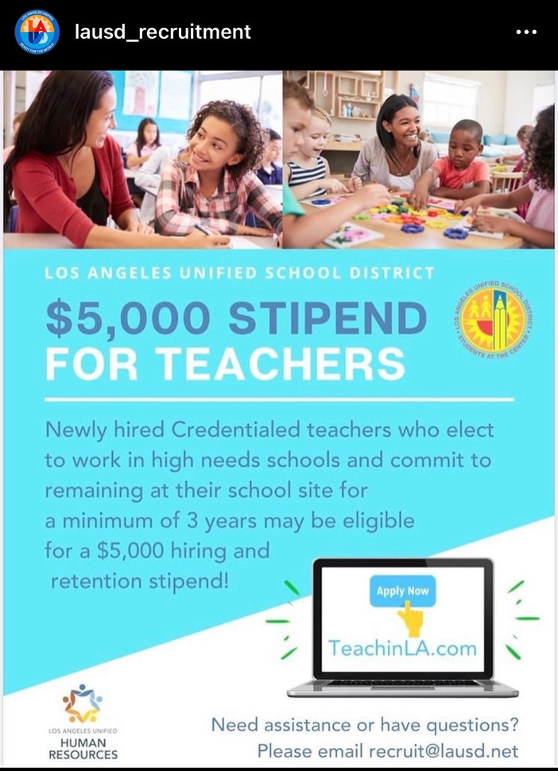
Job Posting
Potential candidates are often browsing on a mobile device.
Use short paragraphs and bullets to break the job down.
Notes:
Creating your job posting
What is it that you are looking for?
Consider advertising for the position with a different title the working title to attract a different audience.
Make the intro as clear as possible.
Ineffective: The incumbent for this job will have experience
with Word, Excel, Powerpoint, Access,
typing, filing, maintaining file system, data entry, taking
notes in meetings, and completing general office duties as assigned.
Effective: If you're the right person for this opportunity, you will have
previous experience providing administrative support to a busy office and using Microsoft Office.

Slide 10
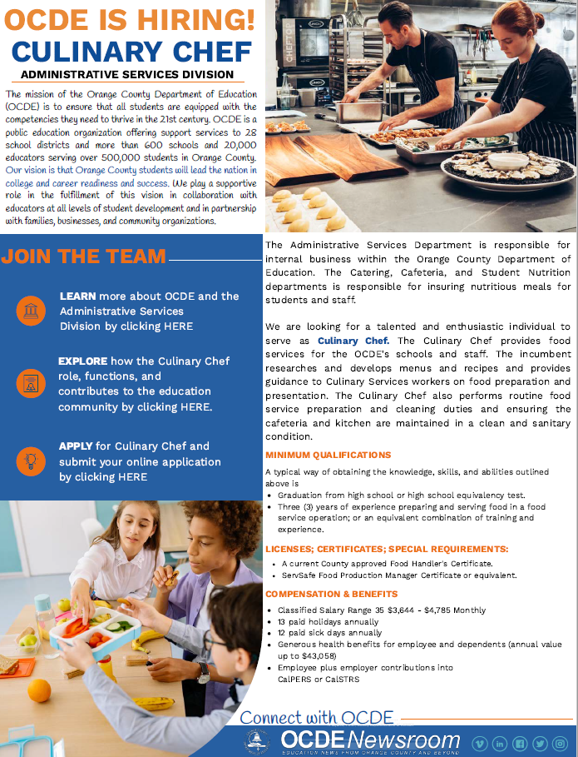
Creating Flyers
Brief Description
Summarize the Role
Requirement and Licenses
Notes:
Creating your job posting
What is it that you are looking for?
Consider advertising for the position with a different title the working
title to attract a different audience.
Make the intro as clear as possible.

Slide 11
Marketing
Understanding your target audience’s behaviors, needs and preferences an ongoing part of your recruitment marketing practice. People are dynamic and what you thought you knew about your audience yesterday may not be relevant today.
Notes:
Now that we have talked about what your
company is about and you have a
dynamic job posting how are you going to
get the positions to your intended audience?
To understand an audience, think about their behaviors,
needs, motivators and value drivers.
In understanding your audience there
is a higher likelihood to reach them and get them to apply.

Slide 12
Marketing
Social Media
Colleges/University
Job Fairs
Referral Bonus
Signing Bonus
Newspaper or Radio
Betterteam
Notes:
As part of the company brand having an active Social Media account is beneficial.
Connect with others that will be able to reach your target audience.
Handshake
Jobspeaker

Slide 13
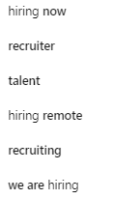
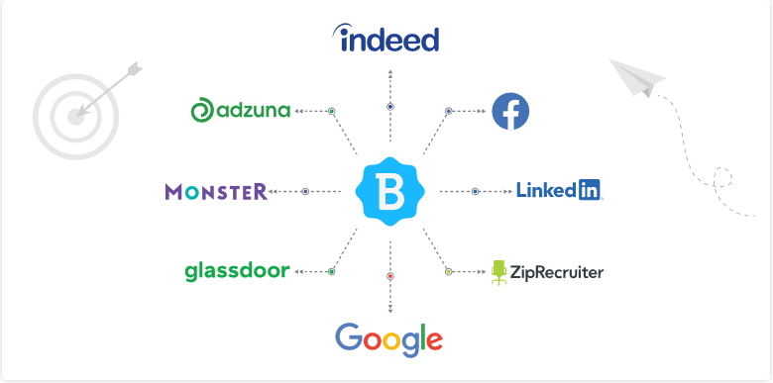
Marketing
Use hashtags (#) to assist those interested in a topic find your post easier using key words
Notes:
As part of the company brand having an active Social Media account is beneficial.
Connect with others that will be able to reach your target audience.

Slide 14
Talent Search
Act as your own headhunter, don't wait for candidates to find you go find them.
Review prospective candidates on sites like LinkedIn and Zip Recruiter.
Notes:
We have talked about how hiring trends have changed in favor
of the applicants, now we need to look at how to find, attract, and keep applicants.
Many recruitment sites also offer the ability to review applications.
Zip Recruiter and LinkedIn
Review previous applicants to see if they qualify for other positions.
Consider contacting them to see if their skills have increased.

Slide 15
Invest in Employees
LinkedIn Learning
Professional Development Training
Tuition Reimbursement/Stipends
Notes:
Investing in your employees helps to prevent turn over.
Attracts more talent

Slide 16
Questions?

Slide 17
Thank You
Melissa Chartrand
mchartrand@ocde.us
Zainab Nuhaily
znuhaily@ocde.us

